Slide 1
Phrases and Clauses
Ms. Dymek
7th Grade English

Slide 2
A Phrase:
Has only nouns and verbs
Does not contain subjects and predicates
Can also be called sentence fragments

Slide 3
Examples
Sniffed at the cat food
Ran towards the mouse
If you look at the above phrases, do we know who or what is doing the sniffing or the running?
Nope! This means there is not a subject making it a phrase. No subject? No predicate.
However, these sentences have nouns and verbs such as…
cat food, the mouse sniffed, ran

Slide 4
Clauses
A group of words that contain subjects and predicates
Divided into
Independent clauses
Dependent clauses

Slide 5
Independent Clauses
Contain subjects and predicates
Can stand alone as a complete sentence

Slide 6
Examples
Poe smelled the cat food.
Pip ran towards the mouse.
In the above clause, we have taken our phrases and added subjects. This makes them clauses.
Our subjects are Poe and Pip.
Because they do not have a subordinator and have subjects and predicates, they are independent clauses and can stand alone as complete sentences.

Slide 7
Dependent Clause
Contain subjects and predicates
Cannot stand alone as a complete sentence
Has a subordinator
They are also known as
subordinate clauses

Slide 8
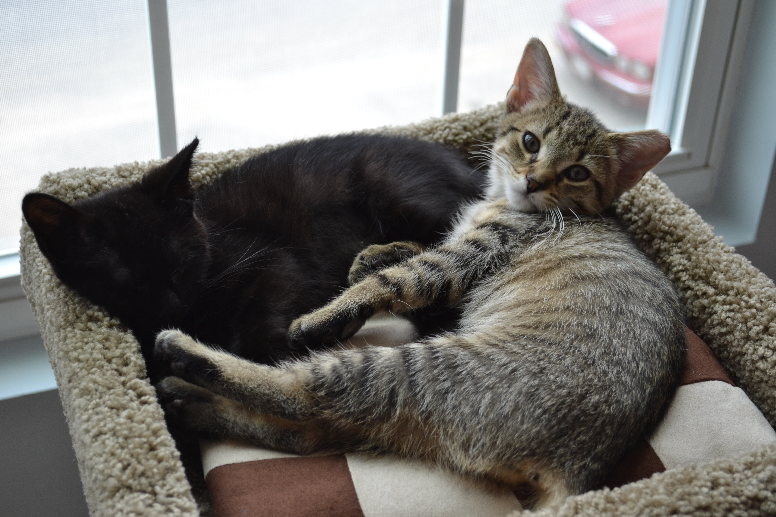
Examples
When Poe sniffed the cat food
As Pip ran towards the mouse
If you read these clauses, you will find that there are questions that are unanswered.
What happened when Poe sniffed the cat food? As Pippa ran, what happened?
Dependent clauses will always start with a subordinator

Slide 9
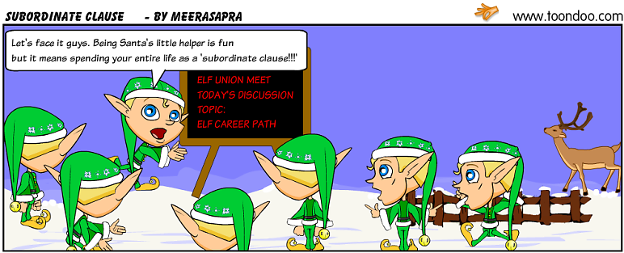
If you find one of the following words, a subject, and a predicate, you will have a dependent clause.

Slide 10
Practice A: Identify whether each is a phrase (P) or clause (C). They do not have punctuation, but that does not mean they are not clauses!
1. Stepping through the waterfall _____
2. Carrying all of her groceries _____
3. Poe eats bugs _____
4. Because I said so _____
5. Since Bernie is super strong _____
6. The best month _____
P
P
C
C
C
P

Slide 11
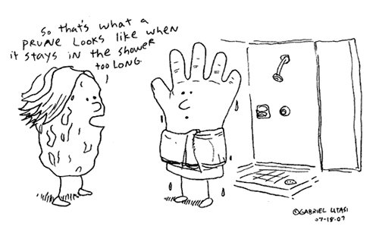
Practice B: Identify whether each is an independent clause (I) or dependent clause (D). Hint: if it has a subordinator, it is a dependent clause.
7. After I ate prunes _____
8. Prunes are delicious _____
9. My mom hates prunes _____
10. Prunes are shriveled plums _____
11. How the bag of prunes looks _____
12. When Grandma’s bag of prunes fell _____
D
I
I
I
D
D

Slide 12
Practice C: Circle the simple subject and underline the simple predicate in the following clauses. Remember: the subject is the main noun of the sentence, and the predicate is what the subject is doing (or it is a linking verb)
13. After the first bovine arrived
14. Cows make milk
15. Although cows produce 25 gallons of saliva
16. Pasteurization was introduced in 1895
17. While cows cannot walk down stairs
Subject: bovine Predicate: arrived
Subject: cows Predicate: make
Subject: cows Predicate: produce
Subject: Pasteurization Predicate: was
Subject: cows Predicate: cannot walk

Slide 13
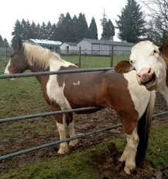
18. A cow can eat around 40 lbs of food a day
19. Red is used to attract bulls in a bullfight
20. Even though cows are colorblind
21. Since they can walk upstairs
22. When a cow smells odors five
miles away
Subject: cow Predicate: can eat
Subject: red Predicate: is used
Subject: cows Predicate: are
Subject: they Predicate: can walk
Subject: cow Predicate: smells

Slide 14
Practice D: How can we use the following dependent clauses and make complete sentences? Complete the sentence by adding a relevant independent clause.
23. While Frank waited on Henrietta, …
24. … since Frank was being grumpy.
25. Considering they were already late for Bingo, …
Now add a dependent clause to complete the sentence. You will need to use a subordinator!
26. Bernice was crabby…
27. … Henrietta yelled at Bernice.

Slide 15
23. While Frank waited on Henrietta, …
24. … since Frank was being grumpy.
25. Even though they were already late for Bingo, …
What did he do?
While Frank waited on Henrietta, he played xBox.
While Frank waited on Henrietta, he got angrier.
While Frank waited on Henrietta, he called his best friend Norman.
What happened as a result of Frank being grumpy?
Henrietta started yelling since Frank was being grumpy.
No one wanted to go with him since Frank was being grumpy.
They didn’t go to the movies since Frank was being grumpy.
What happened despite them being late?
Even though they were already late for Bingo, Henrietta wanted to go to Taco Bell.
Even though they were already late for Bingo, Frank had to find his socks.
Even though they were already late for Bingo, they had to take the dogs for a walk.

Slide 16
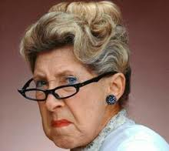
26. Bernice was crabby…
27. … Henrietta yelled at Bernice.
Why was Bernice crabby? When was she crabby?
Bernice was crabby because she hated Bingo.
Bernice was crabby when Frank drove really slow.
Bernice was crabby since she didn’t get to stop at Taco Bell.
Because was crabby while they drove to Bingo.
Why did Henrietta yell at Bernice? When did she yell at Bernice?
When Bernice showed up late to Bingo, Henrietta yelled at Bernice.
Because Bernice didn’t bring her Taco Bell, Henrietta yelled at Bernice.
Even though Bernice brought her Taco Bell, Henrietta yelled at Bernice.
Since Frank was being a jerk, Henrietta yelled at Bernice.

