Slide 1
Edgar Allan Poe: A Quick Timeline
Ms. Dymek
7th Grade English

Slide 2
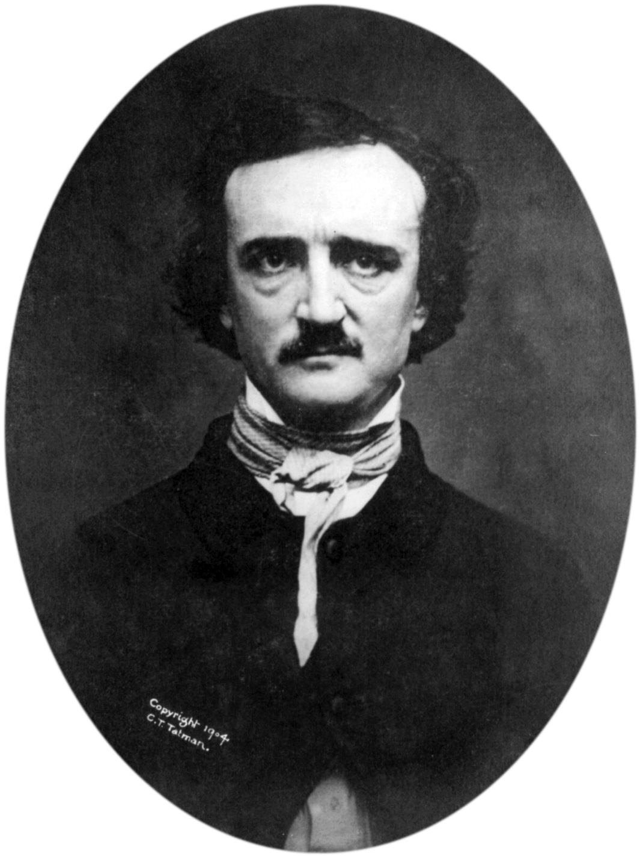
WHAT DO WE ALREADY KNOW ABOUT…

Slide 3
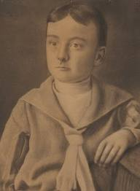
Recapping Poe’s Childhood
Born on January 19, 1809 to actors David and Eliza Poe
Poe’s mother died in 1811 during childbirth
Alcoholic father had already orphaned Edgar and siblings prior to death of Eliza
Edgar is taken in by the Allans—John and Frances
He was never formally adopted by them
Spent several years attending school in London with the Allans because they had money
Attended school in Richmond, VA (1821-1825)
Enjoyed Latin, poetry, acting, and swimming

Slide 4
As a young adult…
Poe was QUITE the rebel!
Childhood sweetheart was Sarah Elmira Royster
They ended up losing touch after he attended UVA and married someone else. Royster’s father STRONGLY disapproved of Poe
1826--Became a student at University of VA
UVA had strict rules about drinking, gambling, smoking
Incurred gambling debts
Had to leave in 1827 after one semester after a quarrel with John Allan and Poe could no longer pay tuition
1827—Published “Tamerlane and Other Poems”
He was 18 when this was published!
Enlists in Army at West Point Military Academy
1831--Expelled after rumors of insubordination
Since he was estranged from his family, he enlisted as Edgar J. Perry. He said he was 22, but he was only 18.

Slide 5
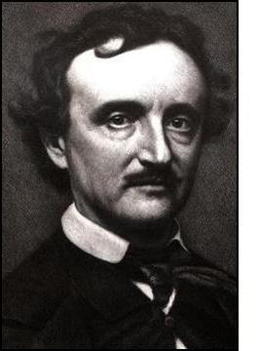
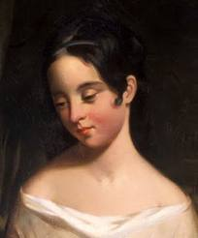
So his life takes a turn…
Poe lives in Baltimore with aunt, Maria Clemm, and her daughter Virginia
Publishes Poems: Second Edition containing “To Helen”
1834—John Allan dies in March
1835—Poe begins courting Virginia and returns to Richmond
Joins The Messenger and increases their circulation
1836—Marries Virginia in May
He is 27. She is 13.

Slide 6
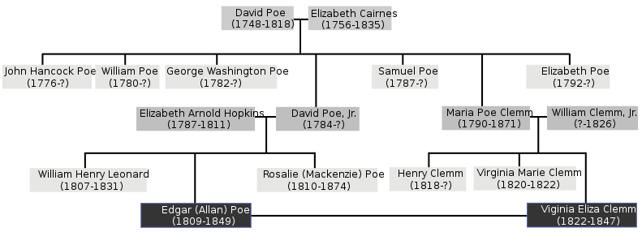

Slide 7
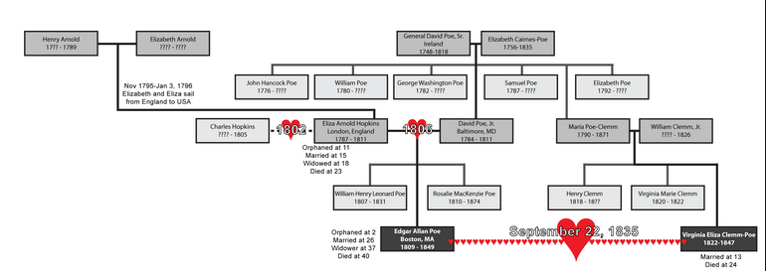

Slide 8
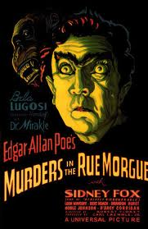
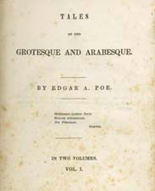
And Another Turn…
1837- Resigns from The Messenger
Moved to New York in January
1839—Becomes an editor of Burton’s Magazine
Publishes a scientific textbook
1840—Publishes Tales of the Grotesque and Arabesque
Includes “The Fall of the House of Usher”
Loses job at Burton’s after fight with boss
1841-1843: Publishes 7 short stories
”Murder in the Rue Morgue” considered the first modern detective story

Slide 9
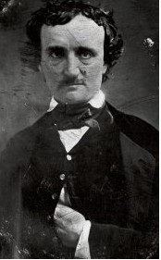
Later in life…
After Virginia’s death, Poe attempted suicide by taking opiates. He posed for this picture four days later.
1845—Publishes “The Raven”
Considered the most popular American poem
1847—Virginia Clemm dies after long illness
Poe falls ill with tuberculosis (50% of people with it die) and begins to drink heavily
Tries to court Sarah Helen Whitman, but engagement failed due to his drinking and erratic behavior
1848—Continues publishing and speaking
Drinking increased
1849—Becomes engaged to widowed Sarah Royster
Dies on October 7, 1849—death not publically announced
only 10 people attend his funeral

Slide 10
Some Other Interesting Things…
Poe was paid only $9 for “The Raven.”
Poe was often seen with a cat perched on his shoulder, especially when he wrote.
In 2009, a copy of Tamerlane and Other Poems was sold at auction for $662,500.
He never signed anything Edgar Allan Poe, only E.A. Poe or Edgar A. Poe.
He was one of the (if not the first) writer to try to make a living solely by writing.
He was good friends with Charles Dickens.
After writing a negative review of a rival named Rufus Wilmot Griswold, Griswold went around badmouthing Poe, exaggerating his alcoholism. He also published a false Poe biography.

Slide 11
Something Super Weird…
Edgar’s one and only novel Narrative of Arthur Gordon Pym of Nantucket was about a boat capsizing and the crew members drawing straws for who would be eaten; they drew straws and ate Richard Parker. The book bombed.
Even though Poe said it was a true story, in his time most of the critics didn’t believe him. They were right to think so because at the time Poe’s book wasn’t true, but just 5 years later a similar wreck happened with the same lead character name Richard Parker, but no cannibalism.
Then in 1884 there was another shipwreck where there was cannibalism, and the one who was eaten was indeed Richard Parker.

Slide 12
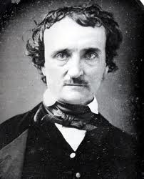
But How Did
He Die??

Slide 13
“On October 3, 1849, Poe was found on the streets of Baltimore delirious, "in great distress, and... in need of immediate assistance", according to the man who found him, Joseph W. Walker. He was taken to the Washington College Hospital, where he died on Sunday, October 7, 1849, at 5:00 in the morning. Poe was never coherent long enough to explain how he came to be in his dire condition, and, oddly, was wearing clothes that were not his own. Poe is said to have repeatedly called out the name "Reynolds" on the night before his death, though it is unclear to whom he was referring. Some sources say Poe's final words were "Lord help my poor soul.” All medical records, including his death certificate, have been lost.”

Slide 14
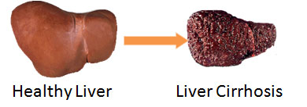
Possible Theories
Alcoholism
cirrhosis of the liver—healthy liver tissue is replaced by scar tissue

Slide 15
Other Theories
2. Murder
3. Tuberculosis
Bacterial infection that affects the lungs (breathing difficulty, chest pain, coughing blood)
4. Brain Tumor

Slide 17
Poe Toaster
The Poe Toaster is an unofficial nickname given to a mysterious person (or more probably two persons in succession, possibly father and son) who, from approximately 1949 until 2009, paid an annual tribute to American author Edgar Allan Poe by visiting the stone marking his original grave in Baltimore in the early hours of January 19, Poe's birthday. The shadowy figure, dressed in black with a wide-brimmed hat and white scarf, would leave three roses and a partially-filled bottle of French cognac, then disappear into the night. Onlookers gathered annually in hopes of glimpsing the elusive Toaster, who did not seek publicity, and was rarely seen or photographed.

Slide 18
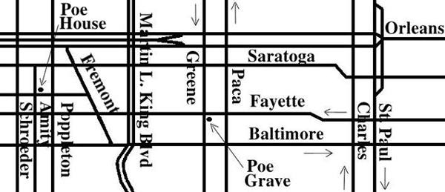
Where Is It In Baltimore?

Slide 19
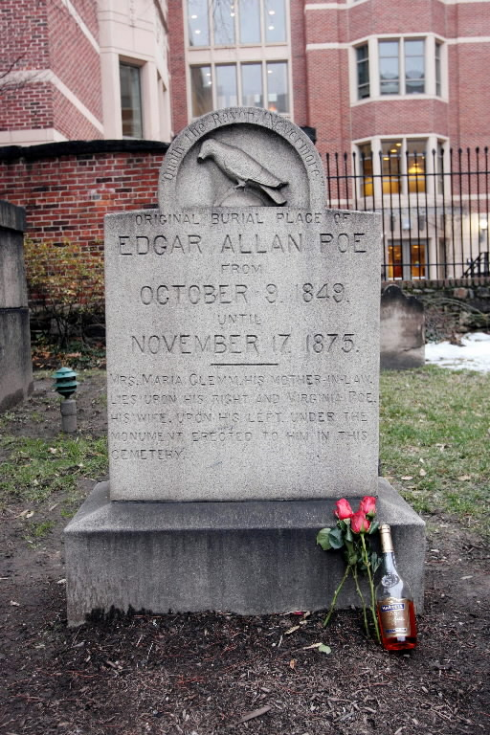
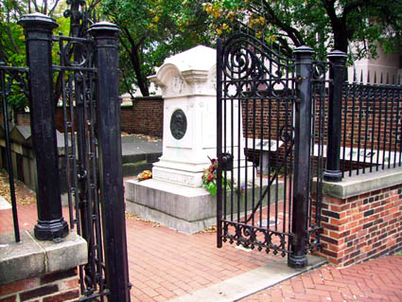
Poe’s Grave

